Slide 1
The World in 2021
Ashok Leyland Session
January 27, 2021 | Shiv - ABG

Slide 2
Structure
The big world events
India events
Basic data and what the future looks like
Impact on family
Impact on employees
Ashok Leyland
Summary

Slide 3
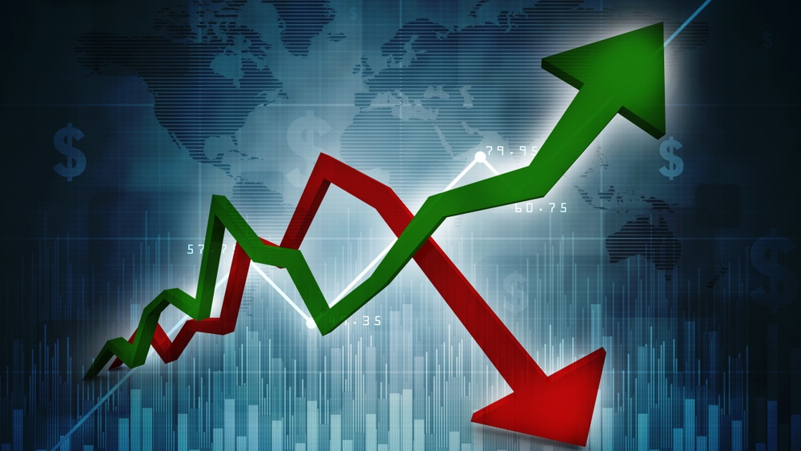
In 2021, we will see high stimulus, hi unemployment, lo interest rates, GDP growth vs a low base.

Slide 4
Overhang of Covid will be seen in 2021 and 2022.

Slide 5
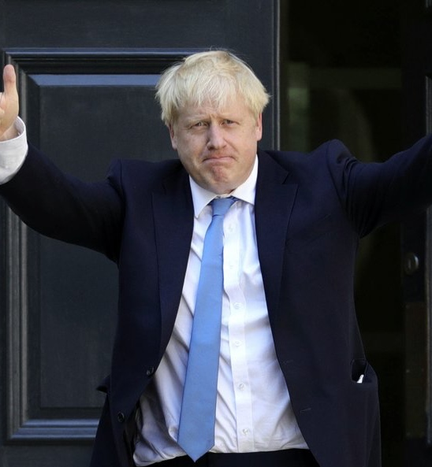
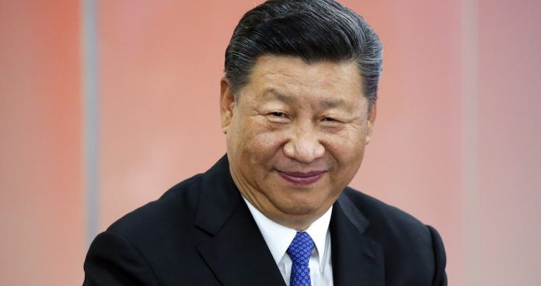
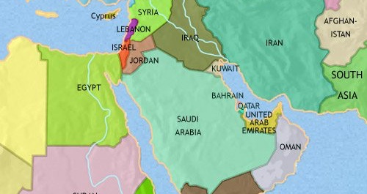
What people will watch closely

Slide 6
GAFT will come under regulatory control.

Slide 7
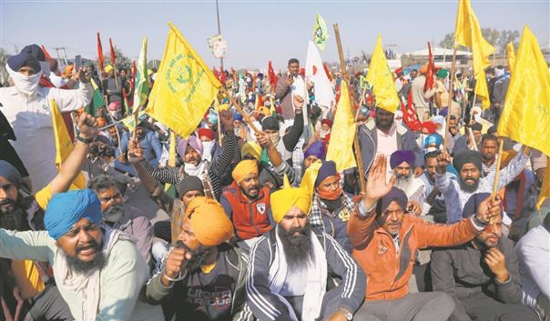
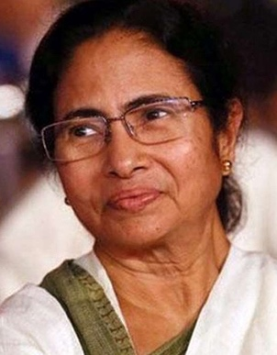
India -What people will watch closely

Slide 8
The Family
Worried about debt
Worried about kids education
Worried about aged parents
Worried about the future

Slide 9
The Individual
Worried about employment and earnings
Work from where?
Travel?
Digital skills
Mental health

Slide 10
The Company
Consumer changing faster than companies
Cost rationalization
Digital business model
Health Responsibility of employees at work
Trust of society

Slide 11
Data for Ashok Leyland
 | 2000 | 2010 | 2015 | 2018 | 2019
Railways length 000 kms | 63 | 64 | 66 | 67 | 67.4
Railways Electrification % | 23 | 30 | 34 | 44 | 51
Passenger revenues Rs bln | 96 | 235 | 422 | 486 | 511
Goods Revenues Rs bln | 221 | 585 | 1058 | 1171 | 1274
Road Network 000 kms | 3374 | 4677 | 5472 | 5898
Freight Railways BTKm | 500 | 600 | 600*
Freight Road BTKm | 400 | 1250 | 2300*
Goods vehicles millions | 3 | 6.4 | 9.2 | 12.2
Buses Millions | 0.7 | 1.5 | 2.1 | 1.9

Slide 12
http://bit.ly/TRCSHIVAKUMAR

Slide 13
Summary
World
Social regulation
India
Individual, Family, Company

