Slide 1
Strategic Decision Making
IIM Calcutta Session | Shiv - ABG

Slide 2
We make hundreds of decisions everyday

Slide 3
Where do we make decisions at work? Whom do we make decisions with? Why do we need to make decisions?

Slide 4
Strategic choices are about
Resource allocation
Time
People
Structure
Partnerships
Brand etc

Slide 5
Strategic decisions have a cost attached
Time
Resources
People
Reputation

Slide 6
Nokia didn’t go with Android

Slide 7
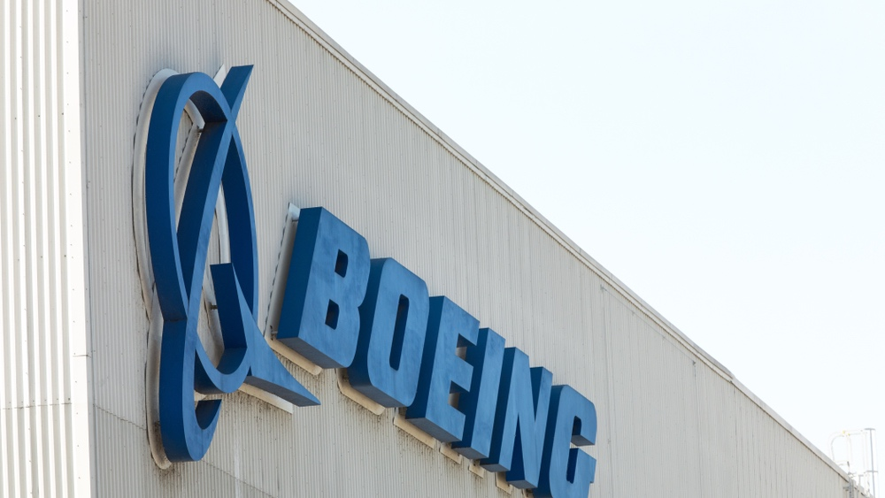
Boeing didn’t respond to Airbus A 380

Slide 8
Meetings for decisions
Boss has decided, so why say anything
I will state my point
This impacts the company
This impact me
We should have looked at more data
We should have asked others
Level of meeting 50,000 feet or 5 feet?

Slide 9
Management by Models

Slide 10
Management by Instinct

Slide 11
Management by Hope

Slide 12
Management by heresay

Slide 13
It was said of Tony La Rona, the baseball manager “ every baseball manager must have a combination skills essential to the trade, part tactician, part psychologist, part river boat gambler”

Slide 14
Summary

