Slide 1
The language of leaders
IIT Patna – Jan 15, 2021 | Shiv ABG

Slide 2
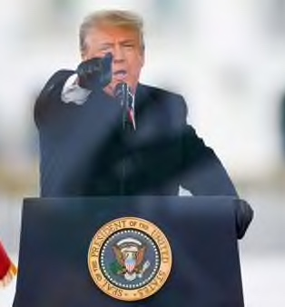
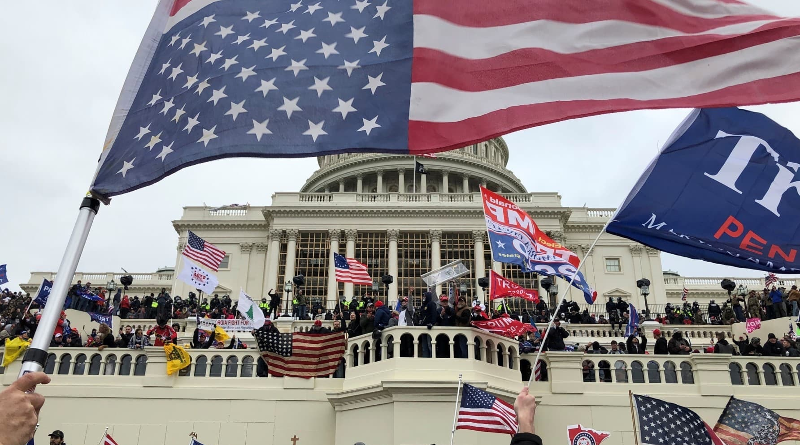
Leaders words scan inspire, incite, instill fear Lesson : Leaders have to be mindful

Slide 3
‘Communication’ is one of the top 3 things people seek in a leader.

Slide 4
Words have power to move people, whether it is the spoken word or the written word. Words are the path to influence, to inspiration, to connect.

Slide 5
In a print world, the leader needed the support of the editor and journalists to amplify his point.

Slide 6
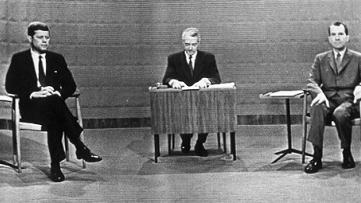
In a TV world, it was important to be photogenic and convey warmth and confidence.

Slide 7
Today it’s a different world, the leader does not need the journalist or the TV anchor, as long as he has followers and has something to engage his base on social media.

Slide 8
But, words are even more important today! No one will let you forget what you said!

Slide 9
Words for a leader are like a paint brush for a painter, a chisel to a sculptor, a bat for a batsman, and a baton for the orchestra conductor.

Slide 10
Leaders use language appropriate for the event, experience and context.

Slide 11
A leader’s language is important in meetings - to decide, to resolve conflicts, to urge people, to pull up casual work, to set a higher standard, to communicate his/her position etc.

Slide 12
Sadly, many sales leaders think that their language has to be colorful @#$%^&*, else its not sales!

Slide 13
The sin of management leaders – Jargon !!
Granular
Synergy
Power ahead
Right to succeed
Downside
Framework
Streamline
Facetime
Hard stop
Paradigm
Circle back

Slide 14
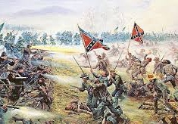
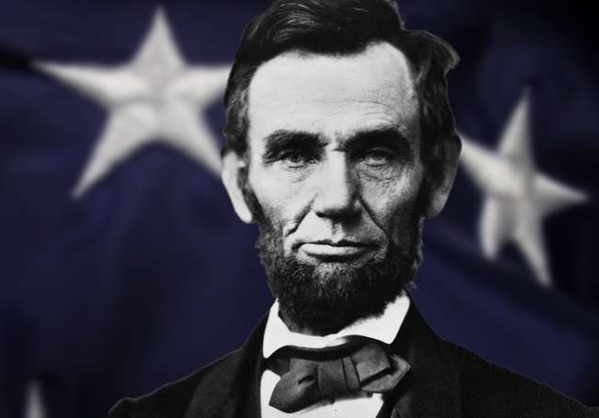
The worlds great speeches - 1
Gettysburg 1863

Slide 15
The worlds great speeches - 2

Slide 16
The worlds great speeches - 3

Slide 17
The worlds great speeches - 4

Slide 18
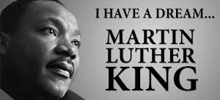
The worlds great speeches - 5

Slide 19
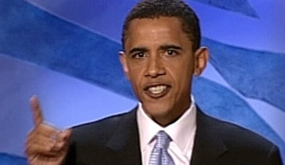
The worlds great speeches - 6
‘We are not the blue states, we are not the red states, we are the United States of America..’ 2004 speech endorsing John Kerry

Slide 20
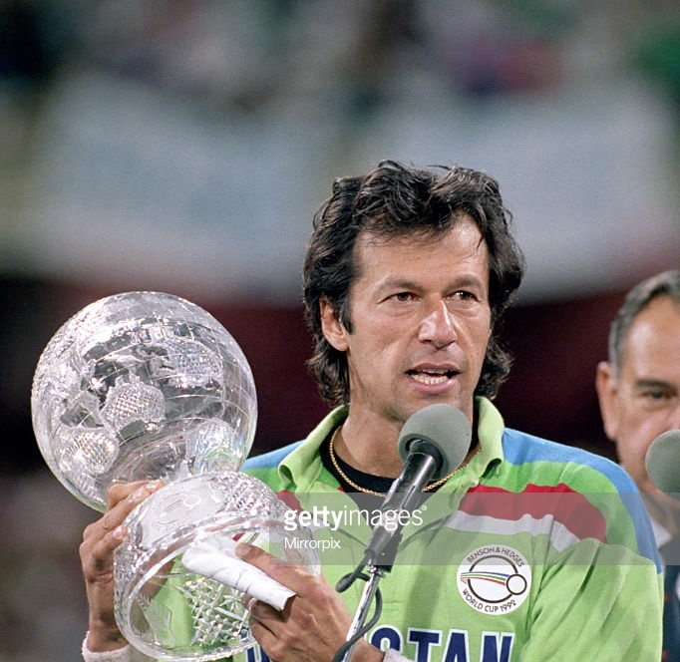
A speech that forgot something

Slide 21
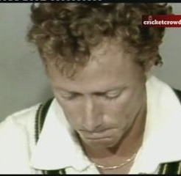
The speech of a defeated leader
Kim Hughes

Slide 22
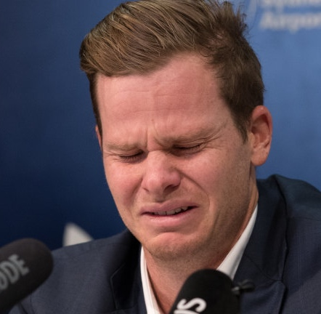
A speech of apology
Steve Smith

Slide 23
What do we learn from these great speeches?
Simplicity
Sincerity
Future picture
Economical
Superlatives
We/Us
Inclusive
Vulnerability
Calmness
Attitude
Urgency
Be the best, achieve the most you can

Slide 24
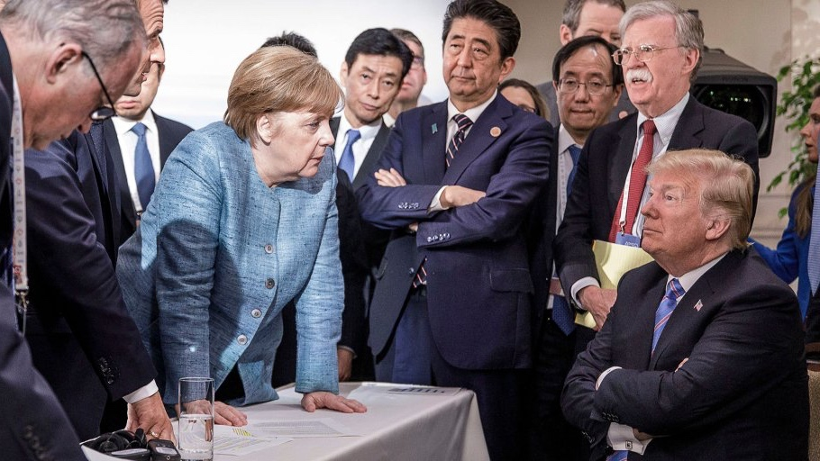
Language has verbal and non verbal cues

Slide 25
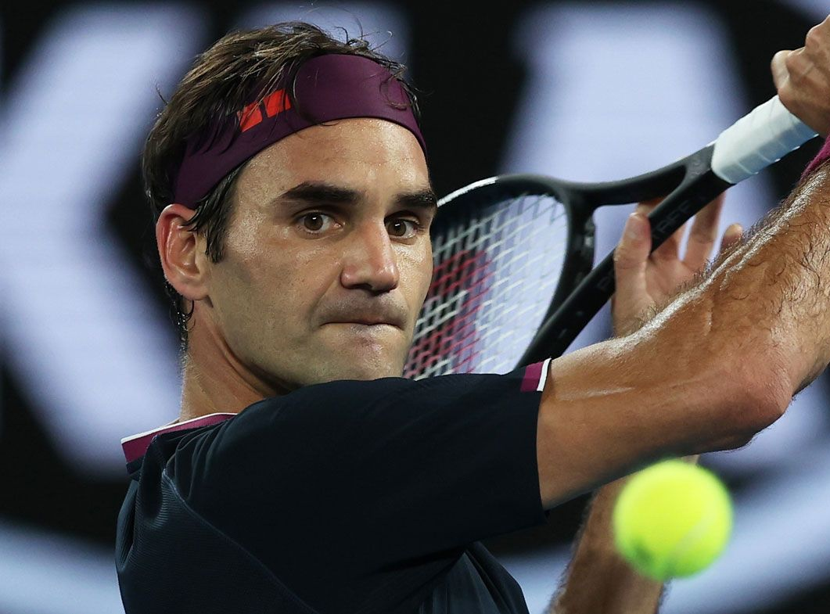
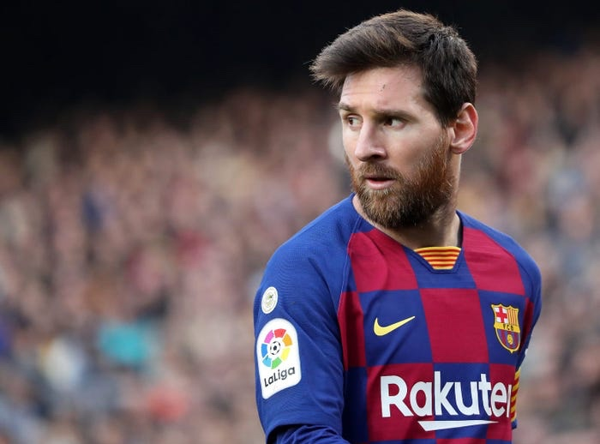
Setting the standard without talking

Slide 26
Tips for leaders
Keep it short and sweet
Rule of 3, have three things for people to remember
Paint a vivid image
Emphasize key words, repeat them if needed
Verbal, Non verbal cues, Stature cues

Slide 27
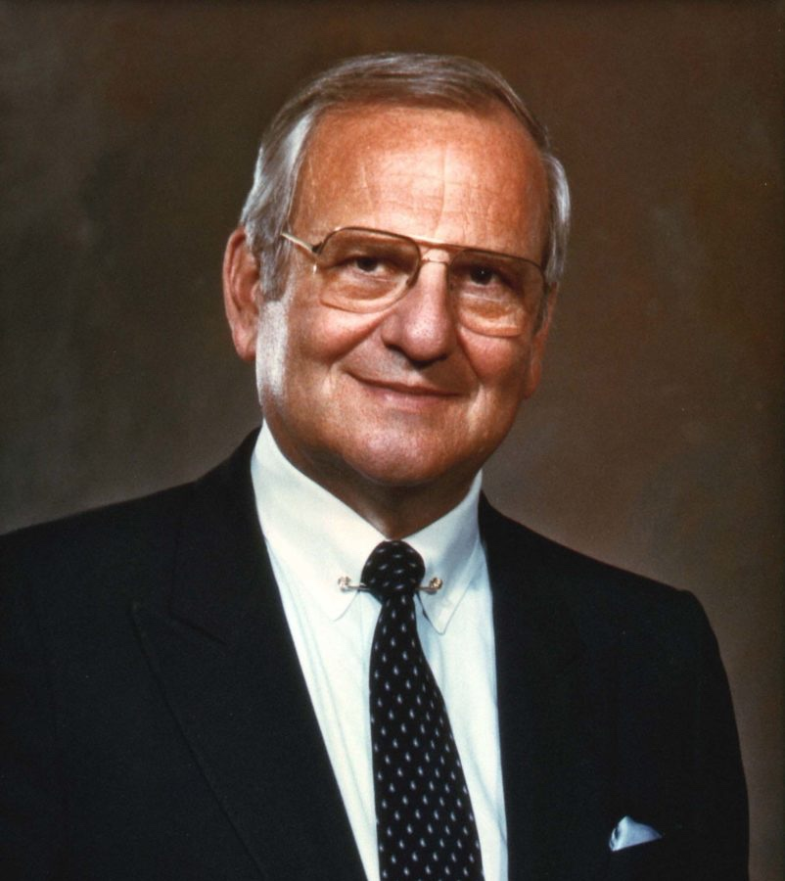
“ Tell them what you are going to tell them, then tell them, and then tell them what you have told them” Lee Iacocca

